Slide 1

Kontizas Team
Galanos Vasilis
Kyrkos kostas
Mouselinos spyros
Mpaltzi sofia
Saltos thomas

Slide 2


Overview
Part I
Reinforcement Learning Applications on Recommender Systems
Part II
Federated Learning Applications on Recommender Systems
95 %
Not started yet

Slide 3
Data
RecSys Challenge 2015 dataset
Dataset is session-based, and each session contains a sequence of clicks
These clicks may have led to purchases or not
For simplicity, we utilize only the clicks sequences
Attempt to give item recommendations appealing enough for the users to click
Original dataset: 9,249,729 sessions and 52,739 items
Reduced the dataset to sessions containing one of the top 500 most popular items, or more.
Filtered out sessions with less than 4 clicks and with more than 10 clicks
That left us with 693,804 sessions and 500 items

Slide 4
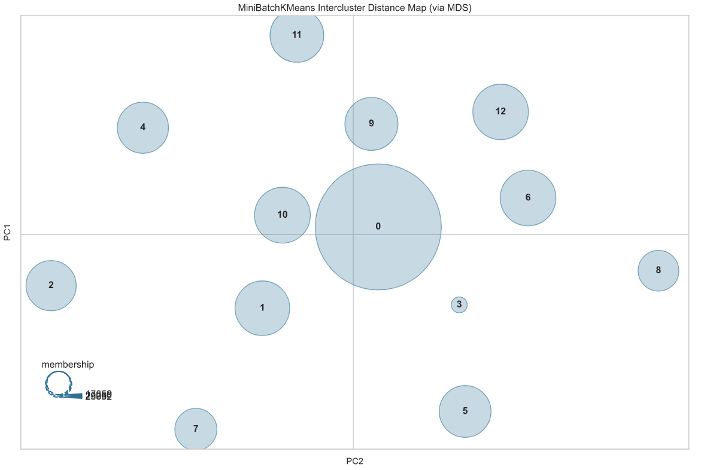
Clustering
Created a TF-IDF encoding of each session based on both the unigram and bigram existence of items
Run Mini-Batch KMeans and tested for 10 to 20 clusters. The optimal number of clusters came up to be 13
Chose one cluster to test our algorithms, but the process would be the same for all cluster
Advantage: more personalized recommendations

Slide 5
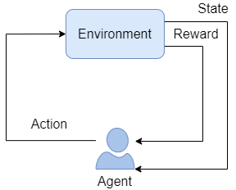
Environment
Created our environment using OpenAI Gym
State: the item that a user has clicked
Action: clicking an item
Reward: + 1 for correct recommendation, - 1 for incorrect

Slide 6
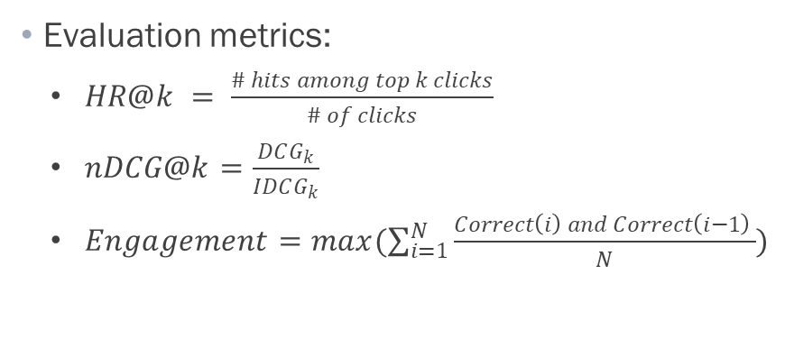
Modeling
Our objective is to create a system for next-item recommendations, meaning that given that a user clicked on a certain item we want to recommend a set of items including one that the user will click next
Evaluation metrics:
$HR@k = \frac{\# hits among top k clicks}{\# of clicks}$
$nDCG@k=\frac{DCG_{k}}{IDCG_{k}}$
$Engagement=max(\sum_{i=1}^{N}{\frac{Correct\left(i\right) and Correct\left(i−1\right) }{N}})$
Three RL algorithms:
Q Learning
Deep Sarsa
Deep Q Learning

